Slide 1
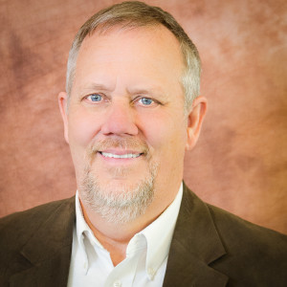
For Disability Accommodations,
please contact Diana Brandt
at (336)334-4547 or djbrandt@uncg.edu
Wednesday, September 12th
5:00pm – 6:00pm Bryan 213
Teddy Burriss
Founder Burriss Consulting
Social networking training…
…that focus on business & individual needs

